Slide 1
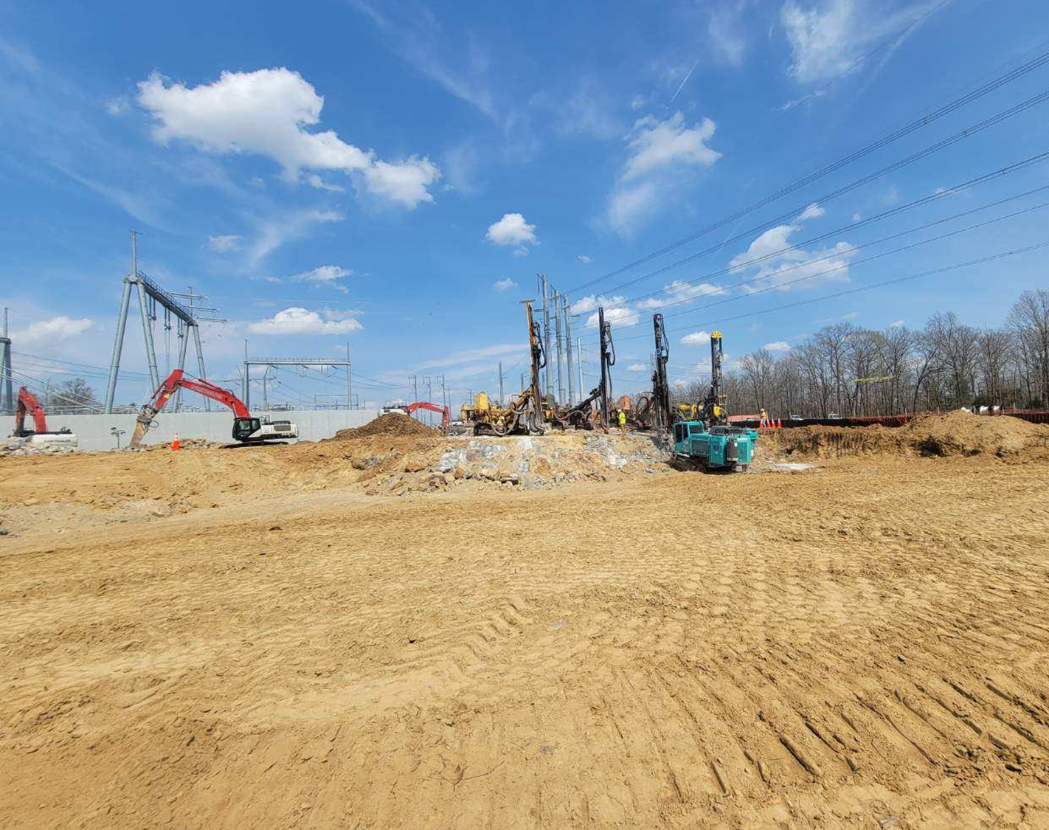
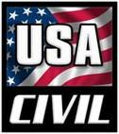
Monique Smith started the company in 2005 in the materials recycling industry and soon became the leader in the Virginia market for Concrete Recycling by providing an array of Recycled Concrete Aggregate (RCA) products. As the company has grown with its clients, she saw the need to expand the services of what the company is today.
Operating as a certified Woman Owned Small Business, USA Civil specializes in providing a best value solution for its customers and their shareholders. USA Civil performs in many client specific industries including Civil Construction, General Contracting, Erosion and Sediment Control, and Access and Road Building. Our experienced staff utilizes state of the art technology coupled with our diverse equipment fleet to fulfill the clients requests. With our established safety culture and environmental stewardship, USA Civil continues to perform as a full service company.

Slide 2
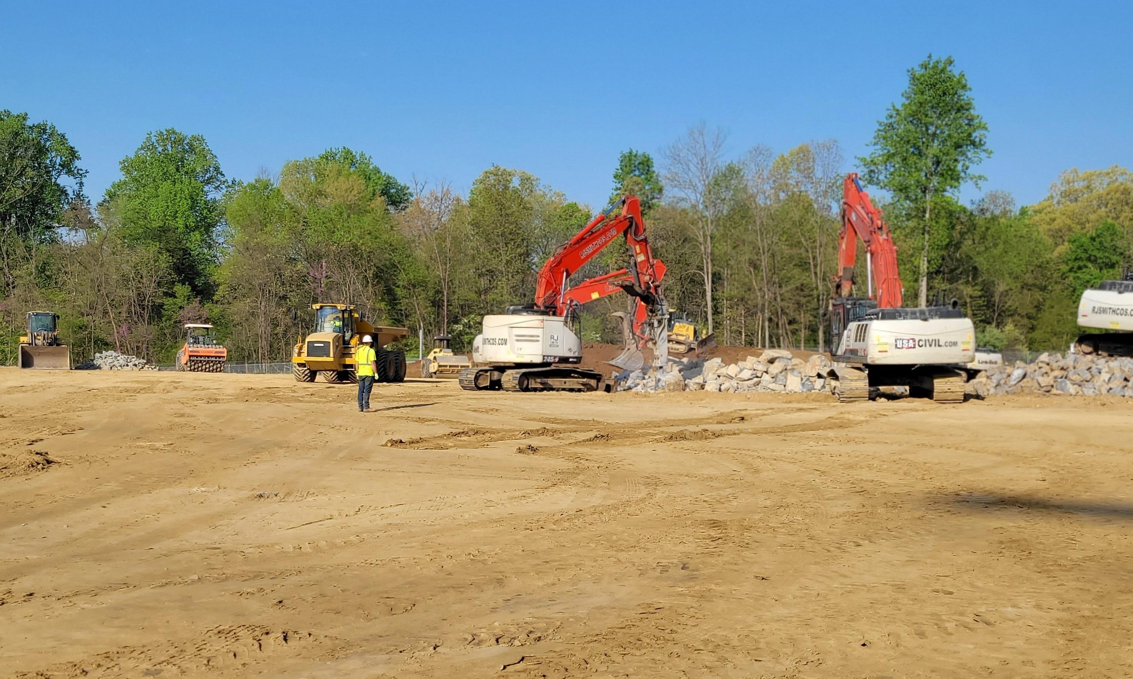
Vendors We Utilize
Trucking – Dump trucks and flatbeds
Traffic Control
Erosion Control Materials
Lodging
Portajohns
Disposal
Utility Location Services
Hydro-excavating

Slide 3
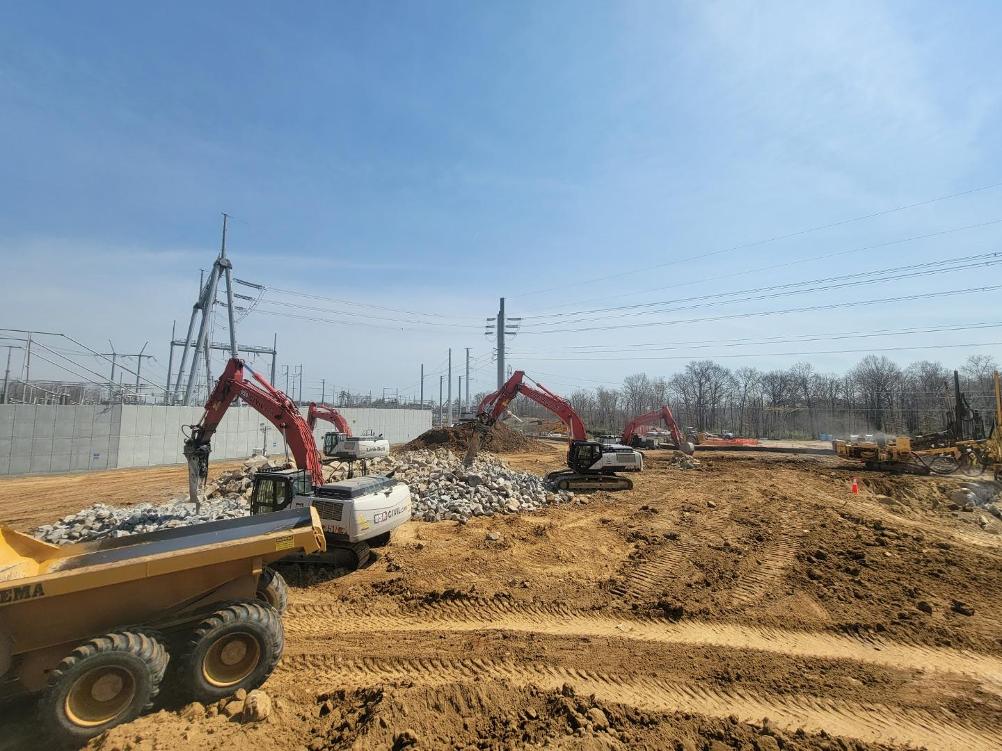
Project Timeframe
Majority of work will take place from now until Fall of 2024. We will still have a presence after that into 2025.

