Slide 1
CVOW Dominion – Supply Chain Event Chesapeake, VA on February 28th
February 2024

Slide 2
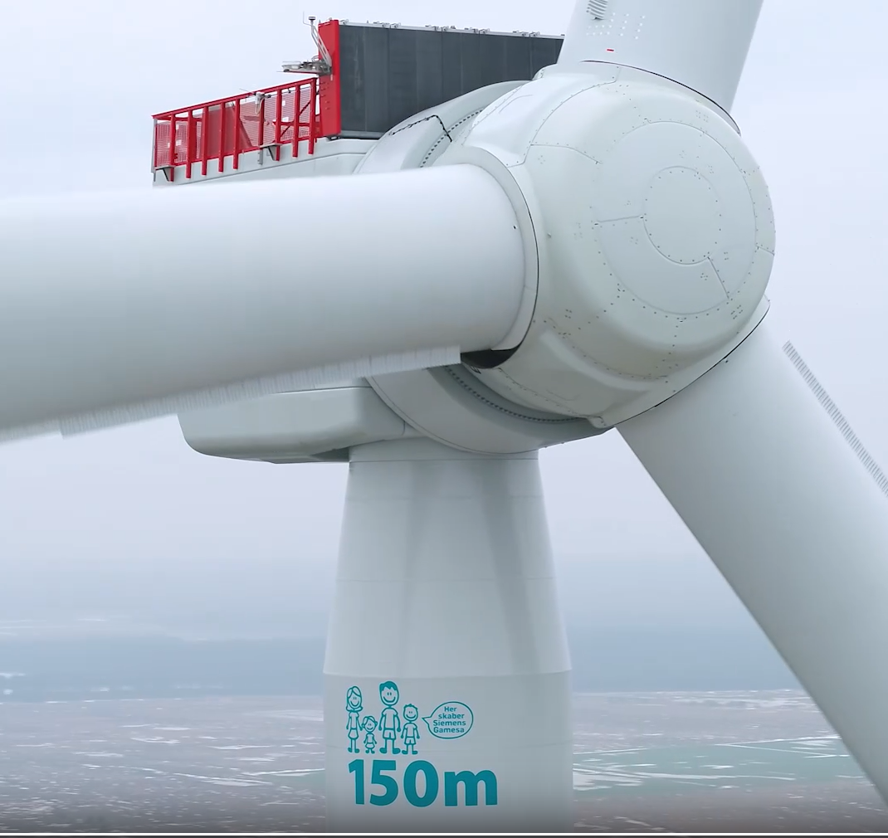
Coastal Virginia Offshore Wind
Watch 'SG 14-222 DD: First Power' | Microsoft Stream
Wind Farm specification
# WTG | 176 No. | Type | SG-14.0 MW-222 DD
Total MW | 2,464 MW – increased to 2,587 MW - Power Boost function
Customer | Virginia Electric and Power Company (Dominion Energy)
Location | Portsmouth / Norfolk Virginia
Scope SGRE Customer: | TSA: Supply and Commission WTGs LTP 10 Year contract Installation vessel, Foundations, Substation, Interconnections
Country:
Timeline specification
Contract effective | 17th December 2021 | Grid connection | 11th Aug 2025
Installation start | 21st Aug 2025 | Contractual TOC | Stage 1 – 01/05/2026 Stage 2 – 29/10/2026 Stage 3 – 19/04/2027
Production Facilities
Nacelle | Cuxhaven
Blades | Aalborg
Harbor set-up
Pre-Assembly | Portsmouth (Virginia)
Crew Change | TBC
Major subcontractors
CTVs | TBC
Tower | TBC

Slide 3
Qualification process
Siemens Gamesa is committed to using local suppliers and Contractors wherever possible & where viable for the Business.
In order to achieve Ready4Business Status the below is a vital pre-requisite for any sourcing relation with suppliers.
Corporate Responsibility (CSR)
Risk Assessment & Environment, Health and Safety (EHS)
Acceptance of Code of Conduct (CoC)
Reliable delivery, competence and quality
Compliance to Code of Conduct controlled by*:
Corporate responsibility self assessment
Supplier Quality audits with integrated Code of Conduct module
External sustainability audit
Notes:
Some SGRE Procurement opportunities –
Local tooling suppliers with out-of-hours availability
Local fabrication and Repair workshops, local to Hull and Humberside areas (Non-Critical)
Suppliers for site infrastructure as needed
Modular Portacabins
Standard Onshore Containers
Warehouse
Couriers and pallet services
Long term accommodation solutions, serviced or otherwise
Taxi and Airport transportation services
PPE suppliers
Waste management providers
Consumables suppliers with out-of-hours availability
On-site Signage

Slide 4
Qualification process
Notes:
Some SGRE Procurement opportunities –
Local tooling suppliers with out-of-hours availability
Local fabrication and Repair workshops, local to Hull and Humberside areas (Non-Critical)
Suppliers for site infrastructure as needed
Modular Portacabins
Standard Onshore Containers
Warehouse
Couriers and pallet services
Long term accommodation solutions, serviced or otherwise
Taxi and Airport transportation services
PPE suppliers
Waste management providers
Consumables suppliers with out-of-hours availability
On-site Signage

Slide 5
Qualification process
Notes:
Some SGRE Procurement opportunities –
Local tooling suppliers with out-of-hours availability
Local fabrication and Repair workshops, local to Hull and Humberside areas (Non-Critical)
Suppliers for site infrastructure as needed
Modular Portacabins
Standard Onshore Containers
Warehouse
Couriers and pallet services
Long term accommodation solutions, serviced or otherwise
Taxi and Airport transportation services
PPE suppliers
Waste management providers
Consumables suppliers with out-of-hours availability
On-site Signage

Slide 6
Project Local Content Tendering Opportunities
Site Personnel Technicians
Spare Part Fabrication
(Non Critical)
Material Handling EQ rental – On-site & Offshore
Onsite Office Accommodation
Short Order Tools and Consumables
WTG Main Components – Towers, Nacelles, Blades
Supply Opportunities
Site Infrastructure & Services
Site Parts for WTG completion
Waste Management
Tower Pre-Assembly
Offshore Logistic Solutions:
Crew Transfer Vessel
Service W2W Vessels
Statutory Inspections
Project Procurement
Strategic Procurement
Possible US Content
Notes:
The overall procurement organization within Offshore has 3 main sub-units:
Strategic Procurement: responsible for all turbine related components. These are all items such as raw materials, standard and specialized parts, sub-assemblies and other direct related services, which are externally purchased by Siemens employees based on MRP (material requirement planning) requirements to assemble or manufacture a complete product as well as for service needs – highlighted in the Yellow callout boxes.
Indirect Procurement: responsible for all catalogue items, i.e., office supplies, travel services, rental cars, hotels etc., IT, trainings, mailing services etc.
Project Procurement: responsible for all services and goods which are not covered within Strategic Procurement / without ECN and often project specific. I.e., logistics, construction, pre-assembly / site set-up of Pre-assembly requirements./Commissioning Harbour. Civil works, fabrication of noncritical items, Plant hire, personnel safety equipment, warehouse articles, Office supplies, Accommodation.
Project Procurement Managers act as Direct interface to the Project execution team for Project and Indirect Procurement.
C-BOP civil balance of plant and E-BOP electrical balance of plant
Opportunities for Local suppliers in the Purple box. Tendering performed on a Project-by-Project Basis
Main Comments tenders fall within the Direct procurement category and are led by the Strategic Procurement team on an annual CAPEX.
Direct Materials
Fasteners
Towers
Steel castings
Blade Materials and components
1) glass fiber
2) epoxy resins
3) carbon fiber
4) small steel parts
5) composite sub-components ; e.g. root segments, spars

Slide 7
Local site procurements (starting in 2025)
CVOW
Activity | Sourced by | Est sourcing date
Cleaning of components- pressure washing | SGRE pre-assembly sub contractor | Apr-25
Consumables | SGRE pre-assembly sub contractor | Apr-25
Containers Onshore | SGRE pre-assembly sub contractor | Apr-25
Crane Mats | SGRE pre-assembly sub contractor | Apr-25
Dust supression -watering | SGRE pre-assembly sub contractor | Apr-25
Office trailers | SGRE and SGRE pre-assembly sub contractor | Apr-25
Office TrailersElectrical SetUp | SGRE pre-assembly sub contractor | Apr-25
Fuel for site | SGRE pre-assembly sub contractor | Apr-25
Lighting towers | SGRE pre-assembly sub contractor | Apr-25
Rental Cars | SGRE | Apr-25
Safety barriers | SGRE pre-assembly sub contractor | Apr-25
Security & Surveillance | SGRE pre-assembly sub contractor | Apr-25
Waste Management | SGRE pre-assembly sub contractor | Apr-25
Office administrator | SGRE | Apr-25
Machine shop | SGRE | Apr-25

Slide 8
SGRE OF PPM SCOPE (Pre-assembly)
February 2024

Slide 9
Pre-Assembly Site Setup
Site Infrastructure
Site Consumables
Construction project office
Warehouse structures
Welfare cabins
…
Tools and small parts
Fasteners
PPE
…
Minimum selection criteria
Code of Conduct acceptance
Corporate Responsibility Self-Assessment
Contractor Safety (HSE)
Industry experience highly valued
Payment terms
SQ audits with integrated Code of Conduct module
External sustainability audit
Procurement
Technology
SCF Evaluation
Quality
Logistics
Site IM Requirements
Others
Plant hire
Transport and Site Vehicles
Stationery and office IT equip
Service accommodation
Port Agents
…
Civil Works
Seabed Remediation
Welding and None critical fabrication
Offshore Temporary Power
……….
Notes:
Some SGRE Procurement opportunities –
Local tooling suppliers with out-of-hours availability
Local fabrication and Repair workshops, local to Hull and Humberside areas (Non-Critical)
Suppliers for site infrastructure as needed
Modular Portacabins
Standard Onshore Containers
Warehouse
Couriers and pallet services
Long term accommodation solutions, serviced or otherwise
Taxi and Airport transportation services
PPE suppliers
Waste management providers
Consumables suppliers with out-of-hours availability
On-site Signage

Slide 10
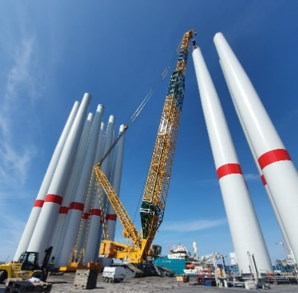
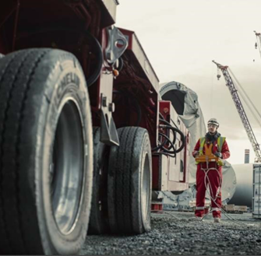
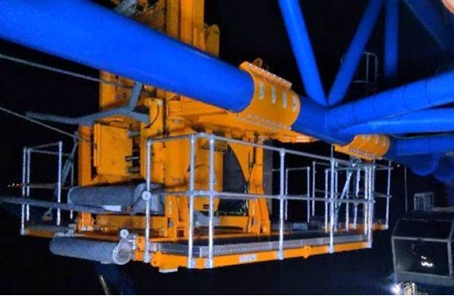
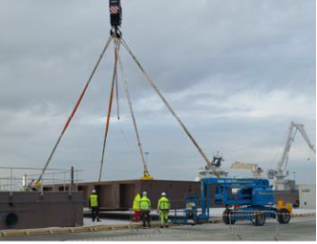
SGRE OF PP Construction Commodity
10
Commodity Overview:
Service | Cranes | Ground Logistics | Traverse System Mob-Demob | Quayside Equipment Mob-Demob
Description | Provision of equipment and personnel for lifting activities for preassembly activities at pre-assembly port | Provision of SPMT and Plant hire equipment for components movement / relocation at site. | Mechanical & Electrical (M&E) work. Installation & removal of SGRE owned traverse system on main crane of IV. | Mechanical & Electrical (M&E) work. Installation & removal of large steel constructs at the pre-assembly site, such as: Compact Tower Frames, X-frames, and Atlas Stands

Slide 11
SGRE OF PP Construction Commodity
Contractor Requirements
In addition to General QHSE requirements and ISO certifications, work related accreditations, trainings and compliance to SGRE Procedures are required to be considered for a tender:
Statutory Inspections by an independent third Party: UKAS A or C accreditation
Installation Technician Contractors must have a pool of technicians trained and in possession of valid certificates relevant for the role as stated in PWTCF Project Wind Technician Competency Framework
After all requirements are met, Supplier Comparison Factor evaluates the Contractor across 4 dimensions: Procurement, Technology, Quality and Logistics:
Procurement
Payment and contract terms Travel cost Visa and Work Permit compliance ...
SCF Evaluation
Procurement
Techno-logy
Logistics
Quality and HSE
Technology
Technological Capabilities & Cooperation Innovation Aspect Wind Experience Tools and Equipment readiness ...
Quality and HSE
Quality performance / SDQ LTFR & TRIR Qualification costs NCC and claim aspects ...
Logistics
Manning Plan Local Resource Availability ...

Slide 12
Any procurement-related inquiries can be sent to
Nicholas Spallone
Siemens Gamesa Renewable Energy Inc Senior Project Procurement Manager Email: Nicholas.Spallone@siemensgamesa.com

Slide 13
Thank you!

