Slide 1
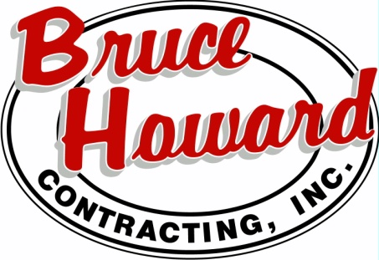
Harpers Site Prep
&
Fentress Security Fence
Notes:
Hi. We are Bruce Howard Contracting, and we have been awarded the responsibility of completing the site work for Harpers Switching Station as well as the installation of the security fence at Fentress Substation for the CVOW project with Dominion Energy
We are excited to present to you a brief overview of our company, the two projects we will be involved with and our purchasing needs at this time.

Slide 2
Background
Founded in 1998
Headquarters located in Charles City, VA
State Certified in Virginia as a Small Woman Owned Business (SWaM)
Federally Certified as a Woman Owned Small Business (WOSB) and Women’s Business Enterprise (WBE)
Licensed Class A Contractor in these Geographic Areas: DC, MD, VA, WVA, NC, SC
Professional Engineer is Licensed in these Geographic Areas: VA, NC
Dominion Energy's System - 20 years
Notes:
After 14 years of experience within the construction development and business community, Betty Howard founded Bruce Howard Contracting, Inc. in 1998. We are State Certified in Virginia as a Small Women Owned Business also known as SWaM. We are federally certified as Women Owned Small Business and Women’s Business Enterprise.
Bruce Howard Contracting’s headquarters is in Charels City, Virginia. We are a licensed class A contractor in Washington DC, Maryland, Virginia West Virginia North Carolina, and South Carolina.
We have been working with multiple departments on Dominion Energy’s System for over 20 years. This includes transmission, distribution and generations

Slide 3
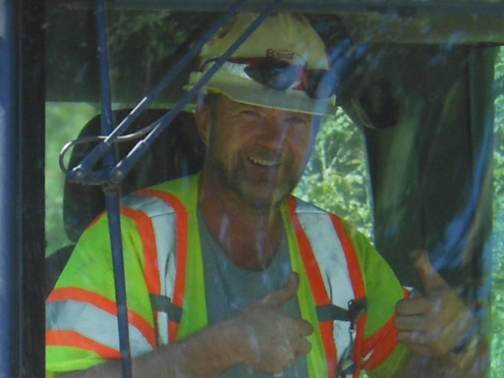
Meet the team
Betty Howard President
Bruce Howard Sr. & Bruce Howard Jr. Vice President’s
Warren Rice Head Safety Officer, Authorized OSHA 500 & 501 Instructor
Daniel Rickmond Director of Engineering
Cody Adkins Project Manager Site Prep
Steve Weagle Director of Operations
Mike Willis Estimator
Chelsea Sachs Director of Business Development
Diana Lopez-Arenas Project Manger Underground Utilities
Cindy Eacho Human Resources
150 +/- employees
BHCI owns over 300 pieces of heavy equipment
“Our most valuable resource is our people.”
Notes:
Bruce Howard Contracting is a family-owned business with roughly150 employees with over 300 pieces of heavy equipment. Betty manages all aspects of the business and as the primary officer holds all the certifications and licenses required to operate the company.
The Howards take pride in their employees and believe their most valuable resources are their people. Many employees have been with the company for over 10 years. The Howards have taken joy in watching their company grow along with their employees.

Slide 4
Services
EXCAVATION & GRADING – SITE WORK
FENCE INSTALLATION
Notes:
Bruce Howard Contracting provides various services from clearing and grubbing, to grading and utilities installation. It is our job to excel at keeping the project on grade, on schedule, and on budget. We build our relationships with our customers and the community just like we build our jobs, starting from the ground up. From planning and permitting to removing E&S controls after the project is completed, we provide unparalleled communication to ensure no phase of the project is undervalued or overlooked.

Slide 5
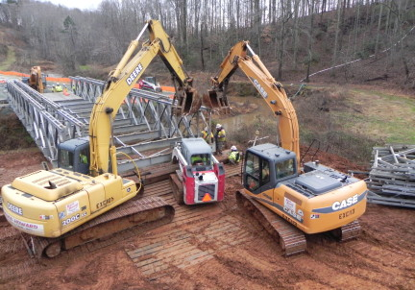
Services
road construction (access)
BRIDGE INSTALLATION
EROSION & SEDIMENT CONTROL INSTALLATION AND MAINTENANCE
Notes:
Additional services we provide are building roads and bridges to safely gain access to work zones while protecting our jobsites by installing and maintaining Erosion and Sediment control devices. From temporary access roads through the most difficult terrain to permanent roads built to VDOT standards, Bruce Howard Contracting can build it.

Slide 6
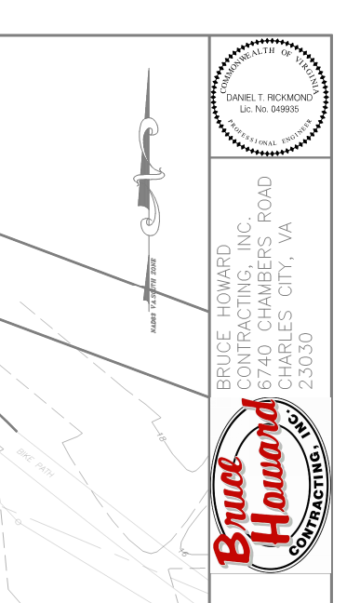
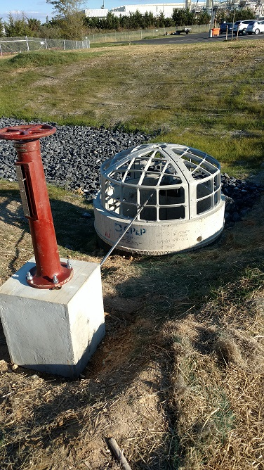
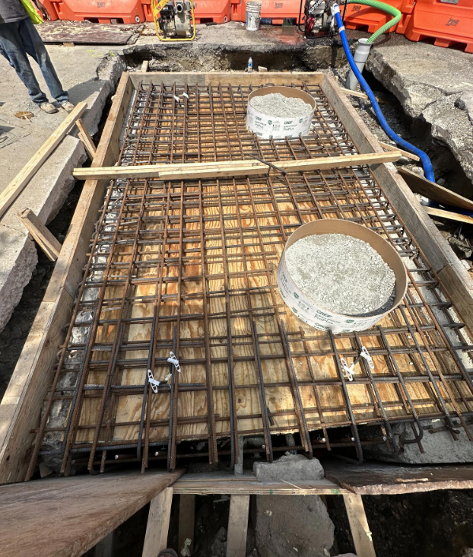
Services
UNDERGROUND UTILITIES
ENGINEERING SERVICES
Notes:
Whether it’s planning and development or design and construction, our licensed Professional Engineer is here to assist with the project from start to finish. Our underground utility crews specialize in installing electrical duct banks that are out of site and out of mind. We help to power your everyday.

Slide 7
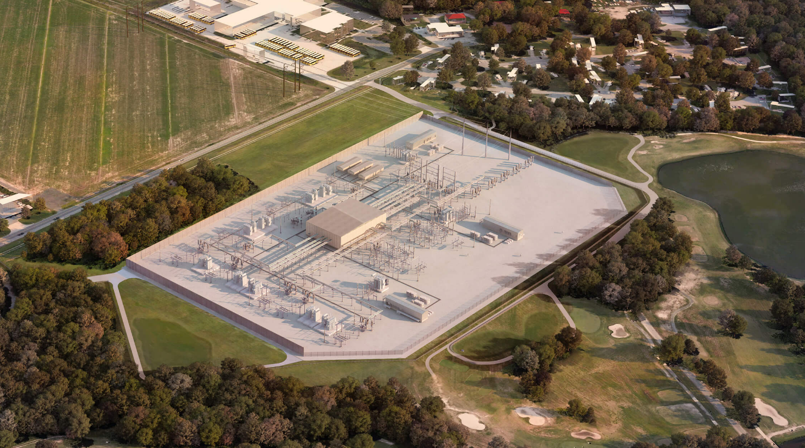
Harpers switching station site prep
Harpers Switching Station will be a 20.9 acre switching substation that is the terminus end for the CVOW underground electrical duct banks and the transition point to overhead transmission lines going to Fentress Substation.
More than 150,000 CY of fill materials and aggregates will be imported for this project.
Local vendors will be instrumental in sourcing goods and services to help keep this project on schedule.
Logistics and transportation will be vital to the success of this project with more than 10,000 loads of materials being hauled by local haulers in the Hampton Roads region.
Economic impacts to the local businesses will be far reaching with new jobs created by the CVOW project.
Bruce Howard Contracting is excited to partner with local vendors and businesses to complete this project.
Notes:
Harpers Switching Station is a 20.9-acre pad that is the transition point for the lines coming from offshore and going to Fentress Substation. More than 10,000 loads of materials are to be locally sourced from the Hampton Roads region to help boost local commerce while helping thousands of people in the region economically. Sourcing help from local haulers, parts suppliers, materials suppliers, as well as hotels will build relationships with the community that will be pivotal to help keep this project on schedule.

Slide 8
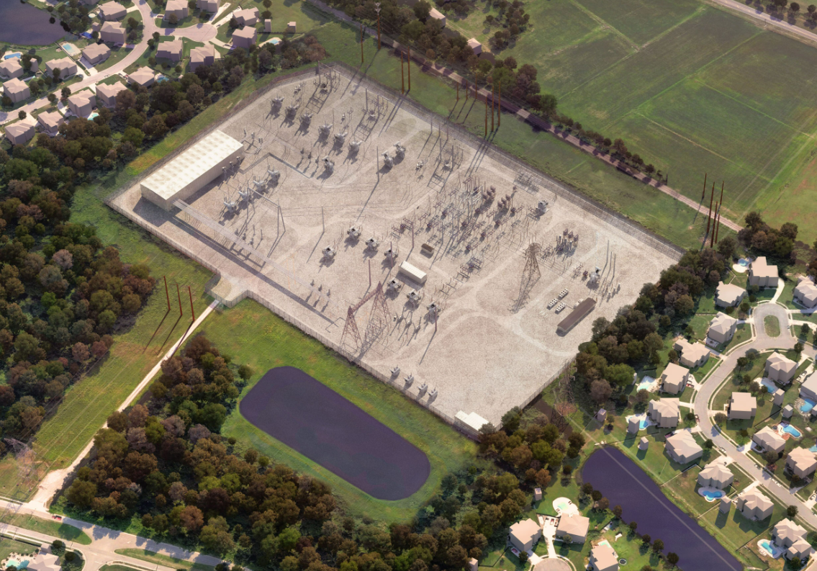
Fentress Substation fence
Fentress Substation is approximately 2,000 linear ft of 20 feet tall Level 1 High Security Fence. It will include 13 super post that will be 25ft tall
BHCI will procure 7000 security fence material from Gaurdiar, the approved manufacturer for Dominion Energy.
Construction material will be purchased from local suppliers, with Chaney Enterprises providing 3,500 psi air-entrained concrete for concrete piers, gate aprons and vestibule pads.
Installation of anti-dig barrier footing between the perimeter fence foundations.
Ensure perimeter grounding on both sides of the fence, ground tails and misc. materials for fence posts, drive gates, security junction boxes, etc.
BHCI will remove previous cut-to-grade fence post outside existing fence line
Notes:
Fentress Security Fence installation is approximately 2,000 linear ft of 20-foot-tall Level 1 High Security Fence. Bruce Howard Contracting is a Guardiar approved installer with experience installing high security fences in the Hampton roads region. We will install an anti-dig barrier footing between the perimeter fence foundation and ensure perimeter grounding on both sides of the fence is established. The safety of our team, our subcontractors and the community are our highest priorities.

Slide 9
Goods or services needed
Outside/For Hire CDL Trucking
Class A CDL Drivers
Equipment Operators
Skilled Laborers
Laydown Area
Disposal Sites
Heavy Equipment Service/Rentals
E&S Control Materials
Fence Materials
Long Term Lodging Accommodations
Electricians

Slide 10
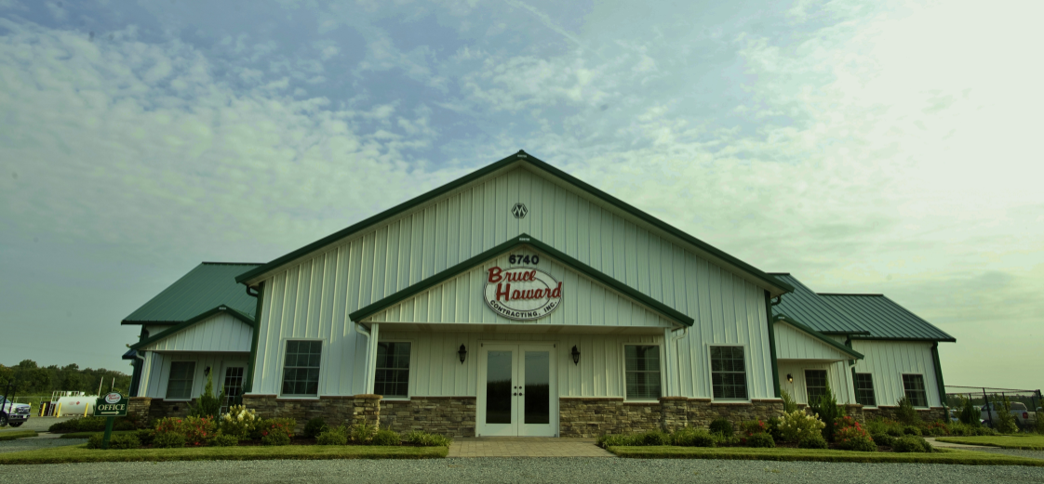
Thank you!
Notes:
Thank you so much for your time and we look forward to meeting you and your company.

